Slide 1
Chapter TWO
Relational Data Model

Slide 2
Chapter Two Contents
2.1 - Terminologies
2.2 - Schemas, Instances and Database State
      2.3 - Properties of Relational Databases
2.4 - Building Blocks of the Relational Data Model
            Entities
            Attributes:
            Relationship
                A. Degree of a Relationship
                B. Cardinality of a Relationship
            Constraints
              Relational Constraints
              Key constraints

Slide 3
2.1 – Terminologies
Relation: is a form of two-dimensional tables :- with rows and columns.
Attribute: a named column of a relation.
Tuple: a row of a relation.
Domain: a set of allowable values for one or more attributes.
Degree: the degree of a relation is the number of attributes it contains.
Cardinality: of a relation is the number of tuples the relation has.
Relational Database: a collection of normalized (appropriately structured) relations with distinct relation names.

Slide 4
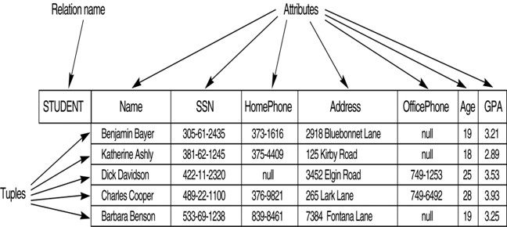
Example
Domain: Student (Name char(50), SNN char(10))
Degree: 7
Cardinality: 5

Slide 5
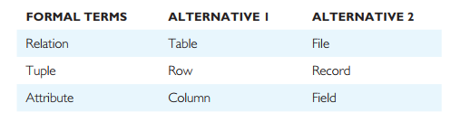
Cont…
Alternative Terminologies

Slide 6
Cont…
Relation Schema: a named relation defined by a set of attribute-domain name pair.
  Let A1, A2...........An be attributes with domain D1, D2 ………,Dn.
  Then the sets {A1:D1, A2:D2… An:Dn} is a Relation Schema.
  Eg. Student (studentId char(10), studentName char(50), age int, DOB date) is a relation schema for the student entity in SQL
Relational Database schema: a set of relation schema each with distinct names.
  Suppose R1, R2,……, Rn is the set of relation schema in a relational database then the relational database schema (R) can be stated as: R={ R1 , R2 ,……., Rn}

Slide 7
2.2 Schemas, Instances and Database State
Database Schema
  In any data model, it is important to distinguish between the descriptions of the database and the database itself.
  The description of a database is called the database schema, which is specified during database design and is not expected to change frequently.
  A displayed schema is called a schema diagram.
  Data type of each item, relationships among the various files and some constraints are not specified in schema diagrams.

Slide 8
Example of a database schema

Slide 9
Cont.…
Database State
  The data in the database at a particular moment in time is called a database state or snapshot.
  Database State: Refers to the content of a database at a moment in time.
  It is also called current set of occurrences or instances in the database.
  Whenever a new database is defined, we specify its database schema only to the DBMS.
  Every time when an update operation is applied to the database, we get another database state.

Slide 10
Cont.…
The database schema changes very infrequently.
The actual data in a database may change quite frequently.
The database state changes every time the database is updated.
The schema is sometimes called the intention and a database state is called an extension of the schema.
Instance
  The term instance is also applied to individual database components, e.g. record instance, table instance, entity instance

Slide 11
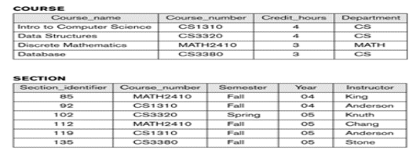
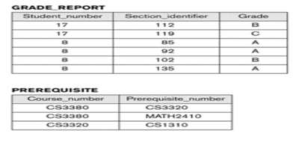
Example of a database state

Slide 12
2.3. Properties of Relational Databases
A relation has a name that is distinct from all other relation names in the relational schema.
Each tuple in a relation must be unique.
All tables are Logical entities.
Each cell of a relation contains exactly one atomic (single) value.
Each column (field or attribute) has a distinct name.
A table is either a Base tables (Named Relations) or Views (Unnamed Relations)
  Only Base Tables are physically stored.
  Views are derived from Base tables with SQL statements

Slide 13
2.4. Building Blocks of the Relational Data Model
The building blocks of the relational data model are: Entities, Attribute, Relationship, and Constraints.
Entities:
    Entity is real world physical or logical object.
    An entity may be an object with a physical existence such as: place (e.g. Building), person (e.g. Student), object (e.g. Car),
    or it may be an object with a conceptual existence such as event (e.g. Registration) or a concept (e.g. Account), which stores data in the database.

Slide 14
Cont…
2. Attributes:
  Attribute is properties used to describe each entity or real world object.
  Each attribute has a name, associate with an entity
    For example: Stud_Id, Stud_Name, and Stud_Age can be the attributes of the student entity with the values “0023’’, “Kebede" and ,"23" respectively.
    Types of attributes
    Simple Vs Composite attribues
    Single-valued Vs. multi-valued attributes
    Stored vs. Derived Attribute

Slide 15
Cont…
1. Simple (Atomic) Vs Composite Attributes
  Simple : Contains a single value (not divided into sub parts).
  E.g. Age, weight, marriage status
  Composite: The attributes that can be divided into smaller subparts, which represent more basic attributes with independent meaning.
  E.g. Name (FN,LN) and address (Kebele, Zone, Wereda,City)

Slide 16
Cont…
2. Single-valued Vs multi-valued Attributes
  Single-valued: have only single value (the value may change but has only one value at one time).
  E.g. Name, Sex, Id.No.
  Multi-Valued: Having a set of values for the same entity.
    May have lower and upper bounds on the number of values allowed for each individual entity.
    E.g. Address, College Degree

Slide 17
Cont’d
3. Stored vs. Derived Attribute
  Stored : not possible to derive or compute. E.g. Name, Address
  Derived: The value may be derived (computed) from the values of other attributes.
    E.g. Age (current year –year of birth), Length of employment (current date- started date) , Profit (earning-cost), G.P.A (grade point/credit hours).
Null Values
  NULL applies to attributes which are not applicable or which do not have values.
  Value of a key attribute can not be null.
Default value - assumed value if no explicit value.

Slide 18
Cont…
3. Relationship:
  Relationship is the association(link, connection) between entities.
  Related entities require setting of LINKS from one part of the database to another.
  A relationship should be named by a word or phrase which explains its function.
  In a relationship there are two basic concepts, These are called DEGREE and CARDINALITY of a relationship respectively.

Slide 19
Cont…
A. Degree of a Relationship
Degree of a Relationship is the number of entities participating in a relationship.
Among the Degrees of relationship, the following are the basic:
  Unary/recursive relationship: Tuples/records of a Single entity are related with each other.
  Binary relationships: Tuples/records of two entities are associated in a relationship e.g. ‘Customer’ and ‘Account’

Slide 20
Cont’d
  Ternary relationship: Tuples/records of three different entities are associated and a generalized one: e.g. teachers teach students &student teaches subjects.
  N-ary relationship: Tuples from arbitrary number of entity sets is participating in a relationship. Doctor, patient, drug & date relation (prescription).
B. Cardinality of a Relationship
  Maximum number of relationship instances that an entity instances can participate in is cardinality of a relationship.

Slide 21
Cont…
The major cardinalities of a relationship are:
One-to-One: one tuple is associated with only one other tuple.
  E.g. Building:-Location as a single building will be located in a single location and as a single location will only accommodate a single Building.
One-to-Many: one tuple can be associated with many other tuples, but not the reverse.
  E.g. Department-Student as one department can have multiple students.

Slide 22
Cont’d
III. Many-to-One: many tuples are associated with one tuple but not the reverse.
  E.g. Employee – Department: as many employees belong to a single department.
IV. Many-to-Many: many tuple is associated with many other tuples
  E.g. Student – Course as many student can take many courses and a single course can be attended by many students.

Slide 23
Cont…
4. Relational Constraints(Integrity Rule)
  Relational constraints are rules that should be obeyed while manipulating the data.
  An integrity constraint (IC) is a condition that is specified on a database schema and restricts the data can be stored in an instance of the database.
  Various restrictions on data that can be specified on a relational database schema in the form of ‘constraints’.
  A DBMS enforces integrity constraints, in that it permits only legal instances to be stored in the database.

Slide 24
Cont’d
Integrity constraints are specified and enforced at different times as below.
  When the DBA or Database designer defines a database schema, he or she specifies the ICs that must hold on any instance of this database.
  When a database application is run, the DBMS checks for violations and disallows changes to the data that violate the specified ICs.

Slide 25
Cont…
Key Constraints
If tuples are needed to be unique in the database, we need to make each tuple distinct.
To do this we need to have relational keys that uniquely identify each record.
Super Key:
  It is an attribute/set of attributes that uniquely identify a tuple within a relation.
    It is not necessary the minimum set of columns required to uniquely identify a row.
    For example, in a table containing employee data, a super key can be the combination of employee ID, first name, last name, and birth date.

Slide 26
Cont…
B. Candidate Key:
  A candidate key is a minimal super key, i.e., a set of one or more columns that can be used to uniquely identify rows within a table, but no subset of this set can do the same.
  It can contain NULL values.
  For example, in the employee data table, the employee ID can be a candidate key because it can uniquely identify each employee.
  If a super key is having only one attribute, it is automatically a Candidate key.
  If a Super key consists of more than one attribute it is called Composite Key.

Slide 27
Cont’d
C. Primary Key:
  There can be more than one candidate key in relation out of which one can be chosen as the primary key.
  Primary key is the candidate key that is selected to identify tuples uniquely within the relation.
    Primary key Value is unique for each record in a table and value cannot be used twice.
    Primary key Value cannot be NULL.

Slide 28
Cont’d
D. Foreign Key:
Foreign Key is an attribute, or set of attributes, within one relation that matches the candidate key of some relation.
    Foreign key is used to create relationships between tables.
    Foreign key is a column whose values are derived from the primary key or unique key of some other tables.

Slide 29
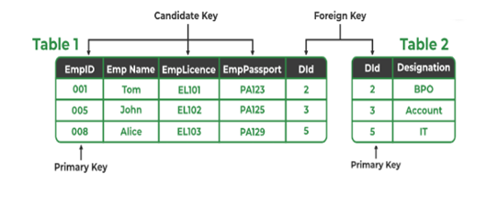

Example
Cont’d

Slide 30
Cont’d
The Relational constraints can be classified into 4 types as below.
  Domain Integrity: No value of the attribute should be beyond the allowable limits.
  Entity Integrity: In a base relation, no attribute of a Primary Key can assume a value of NULL.
  Referential Integrity: If a Foreign Key exists in a relation, either the Foreign Key value must match a Candidate Key value in its home relation or the Foreign Key value must be NULL.
  Enterprise Integrity: Additional rules specified by the users or database administrators of a database are incorporated.

Slide 31
Thank you!!

